Slide 1
Lighting, Material, and Shading
CS 460: COMPUTER GRAPHICS

Slide 2
Lecture outline
Introduction
Light source
Phong Illumination Model
Interpolative Shading
Lighting in OGL

Slide 3
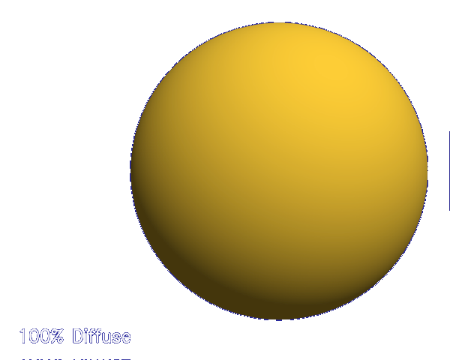
Introduction
light
So far, we’ve talked exclusively about geometry.
  What is the shape of an object?
  How do I place it in a virtual 3D space?
  How do I view it through my virtual camera?
  How do I know which pixels it covers?
Once we’ve answered all those, we have to ask one more important question:
  What value do I set each pixel to?
Answering this question is the job of the shading.
(Of course, people also call it a lighting model, a light reflection model, a local illumination model, a reflectance model, etc., etc.)

Slide 4
Tedious reality
Properly determining the right color is really hard.
Look around the room. Each light source has different characteristics. Trillions of photons are pouring out every second.
These photons can:
  interact with the atmosphere, or with things in the atmosphere
  strike a surface and
    be absorbed
    be reflected
Of course, none of the surfaces here are perfectly flat. At some microscopic level (very important for photons) they’re all really bumpy.

Slide 5
Light source
What is a Light source?
Any object that emits radiant energy
Type of Light source:
Directional
Point
Spot light
More complicated: extended and environment

Slide 6

Directional light source
Sun (infinitely away)
surface
The light source is infinitely away
Homogeneous Coordinate: ( X, Y, Z, 0 )
Incoming light rays are parallel and of same intensity
Easy to compute with because the incoming light direction is the same for all surface points

Slide 7
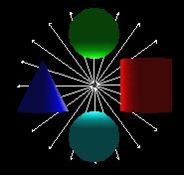
Point light source
Point Light
surface
The light source (zero-volume) locates at a finite distance from the surface
Homogeneous Coordinate: ( X, Y, Z, 1 )
Light rays goes out from the source in all directions
Harder to compute with because incoming light direction varies at different surface point
Attenuation – we may specify how the light goes dimmer with distance

Slide 8
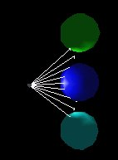
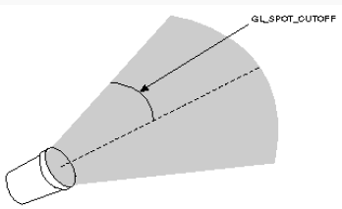
Spot light source
Spot Light
surface
Special Point Light pointing at a particular direction
(inherit all properties of point light source)
cutOffAngle defines the angle of the 3D cone, which restricts the shape of light emitting from the source
In addition to distance attenuation, we may attenuate the intensity of light by measuring its deviation from the spotlight pointing direction

Slide 9
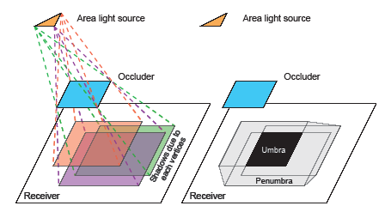

Extended light source
[Sillion]
Extended Light Source, e.g. Line or Area (fluorescent lamp)
Every point along the line or within the area is a
point light source
More Realistic, but computation is very hard
Produce soft shadow: umbra and penumbra
  umbra: shadow region where light source is completely blocked
  penumbra: shadow region where light source is partially blocked
No direct support in OGL, but can be approximated using ray tracing

Slide 10

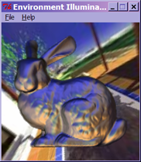
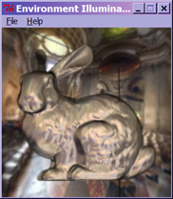
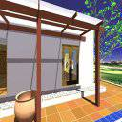
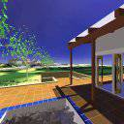
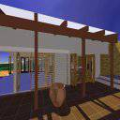
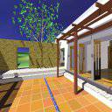
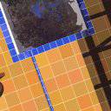
Environment as a light source
Environment assumed to be infinity away
Trace the reflected ray at each surface point
Looks similar to Texture mapping, but
  Texture Mapping is sticked to the object surface
  Environment lighting is sticked to the environment
  Hint: Imagine if we change the viewing direction

Slide 11
The Graphics approach
So far, we have light source, then…
We’re going to build up to an approximation of reality called the Phong illumination model, which describes the interaction between light and surface
It has the following characteristics:
  Not physically based
  Gives approximation to physical light reflection
  Very fast
  Widely used

Slide 12
Iteration zero
Given:
  a point P on a surface
  visible through pixel p
Assign each polygon a single color:
I = k_{e}
where
  I is the resulting intensity (to be written to the frame buffer)
  k_{e} is the intrinsic shade associated with the object (self emission)
This has some special-purpose uses, but not really good for drawing a scene (e.g. using same glColor3f for the whole polygon)
Equal emission to all directions
surface point

Slide 13
Here is what it looks like
Computer screen

Slide 14
Iteration One
Let’s make the color at least dependent on the overall quantity of light available in the scene:
        I = k_{a} I_{a}
k_{a} is the ambient reflection coefficient of the object.
  really the reflectance of ambient light
  “ambient” light is assumed to be equal in all directions,
I_{a} is the ambient intensity of the light.
Physically, what is “ambient” light?
  Answer on next page.

Slide 15
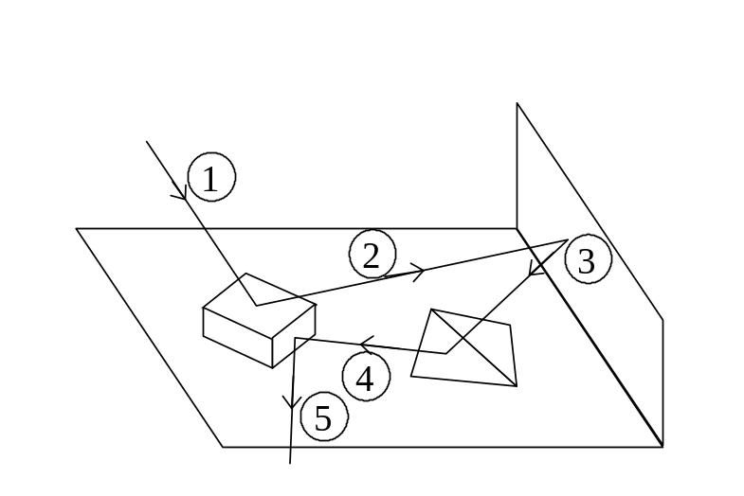
Indirect Illumination (ambient)
Some surfaces are illuminated even they are in shadow. Why?
There is indirect lighting (background lighting) reflected from other surfaces
Each surface illuminated becomes itself a source of light for illumination on other surfaces of the scene.
Each of these surfaces, in turn, reflect light to other surfaces, including the original one, thus achieving an “infinite regression” of reflections and illumination.
Approximation: Simply assume the indirect lighting is constant (same to all objects in the scene) in most graphics systems.
Approximation of
indirect illumination
surface point

Slide 16
Diffuse Reflection
Let’s examine the ambient shading model:
  objects have different colors
  we can control the overall light intensity
    what happens when we turn off the lights?
    what happens as the light intensity increases?
    what happens if we change the color of the lights?
So far, objects are uniformly lit.
  not the way things really appear
  in reality, light sources are directional
Diffuse, or Lambertian reflection will allow reflected intensity to vary with the direction of the light.

Slide 17
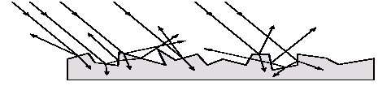
Diffuse Reflector
Diffuse reflection occurs from dull, matte surfaces, like latex paint, or chalk.
These diffuse or Lambertian reflectors reradiate light equally in all directions.
Picture a rough surface with lots of tiny microfacets.
Note:
  Light may actually penetrate the surface, bounce around, and then reflect back out.
  Accounts for colorization of diffusely reflected light by plastics.
In: one direction
Out: equal in all directions
surface point

Slide 18
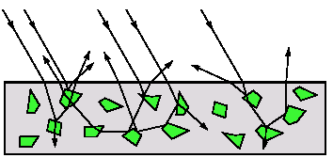
Diffuse Reflector
The reflected intensity from a diffuse surface does not depend on the direction of the viewer (important, remember this). The incoming light, though, does depend on the direction of the light source.

Slide 19
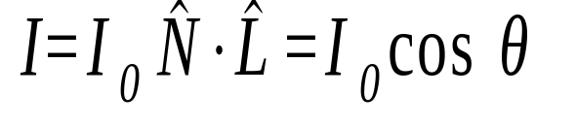
Lambert’s cosine Law
A diffuse surface is one which reflects light equally in all directions and obeys
Lambert’s cosine law
N
L
θ
Note: I₀ is the incoming light intensity
and I is the reflected light intensity

Slide 20
Iteration Two
Based on Lambert’s cosine law, giving the diffuse reflection equations:
I = k_{e} + k_{a} I_{a} + k_{d} I_{l} cos θ
= k_{e} + k_{a} I_{a} + k_{d} I_{l} ( N · L )₊
where:
  k_{d} is the diffuse reflection coefficient.
  I_{l} is the intensity of the light source
  N is the normal at the surface point (unit vector)
  L is the direction to the light source (unit vector)
  (x )₊ means max { 0 , x } (This is an important checking!!!)

Slide 21


Ambient and Diffuse Examples
Increasing the diffuse coefficient:
Increasing the ambient term while keeping the diffuse term constant:

Slide 22


Intensity drop-off with distance
The laws of physics state that the intensity of a point light source must drop off with its distance squared.
We can incorporate this effect by multiplying I_{l} by 1/d².
Sometimes, this distance-squared drop off is considered too “harsh.” Angel suggests using with user-supplied constants for a, b, and c.
With user-supplied constants for a, b, and c.

Slide 23
Specular Reflection
Specular reflection accounts for the highlight that you see on some objects.
It is particularly important for smooth, shiny surfaces, such as:
  metal
  polished stone
  plastics
  apples
Specular reflection also depends on the viewing direction V (important, remember this). The color is often determined solely by the color of the light.
  corresponds to the absence of internal reflections

Slide 24
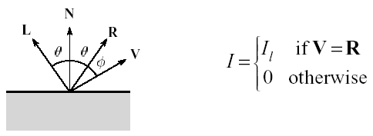
Specular Reflection Derivation
For a perfect mirror reflector, light is reflected about N, so
For a near-perfect reflector, you might expect the highlight to fall off quickly with increasing angle φ.
Also known as:
  “rough specular” reflection
  “directional diffuse” reflection
  “glossy” reflection

Slide 25
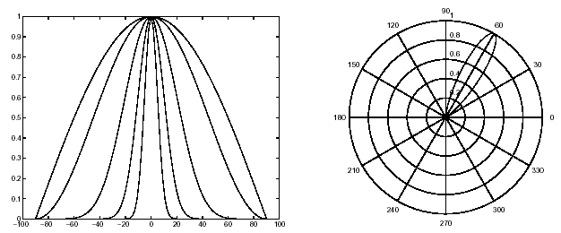
Specular Reflection Derivation
One way to get this effect is to take (R ·V ), raised to a power n_{s} .
As n_{s} gets larger,
  the dropoff becomes { more , less } gradual (ans: less)
  gives a { larger , smaller } highlight (ans: smaller)
  simulates a { more , less } shiny surface (ans: more)

Slide 26
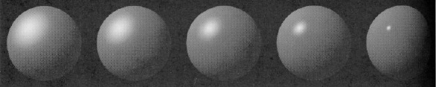
Specular Examples
Effect on varying n_{s:}
Increasing n_{s}

Slide 27
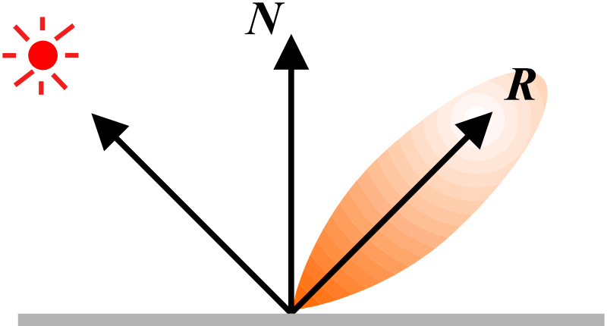
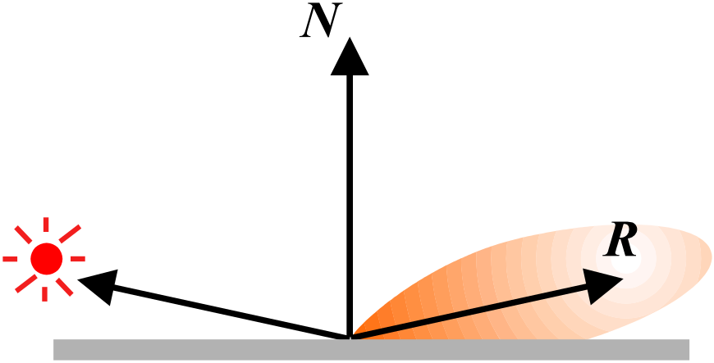
Specular Reflection
Note: Changing the light direction

Slide 28

Iteration Three
Since light is additive, we can handle multiple lights by taking the sum over every light.
Our equation is now:
This is the Phong illumination model.
Beware of the max. operator ()₊ in the above equation
Which quantities are spatial vectors?
Which are RGB triples?
Which are scalars?

Slide 29
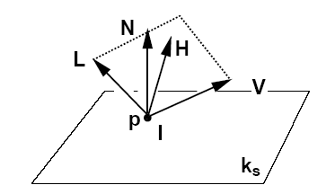
Half Vector H
Since the computation of R is time consuming, Blinn suggested to do this approximation:
V · R ≅ N · H
where H = ( L + V ) / | L + V | .
This is called Blinn-phong shading (see textbook for details).

Slide 30
Choosing the Parameters?
How would I model…
  polished copper?
  blue plastic?
  lunar dust?

Slide 31
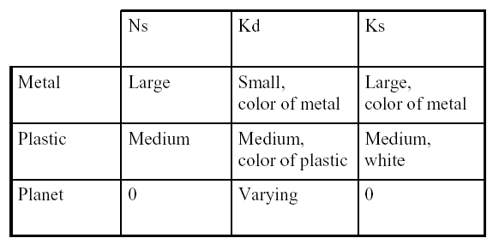
Choosing the Parameters
N_{s} in the range [0,100]
Try K_{a} +K_{d} + K_{s} <= 1
Use a small K_{a} (~0.1)

Slide 32
Appearance of a
diffuse (dull) sphere
3D plot of reflected intensity

Slide 33
Appearance of a
specular sphere
3D plot of reflected intensity
n_s = 15

Slide 34
k_{d} = 0.7
k_{s} = 0.4
n_s = 15

Slide 35
k_{d} = 0.85
k_{s} = 0.25
n_s = 15

Slide 36
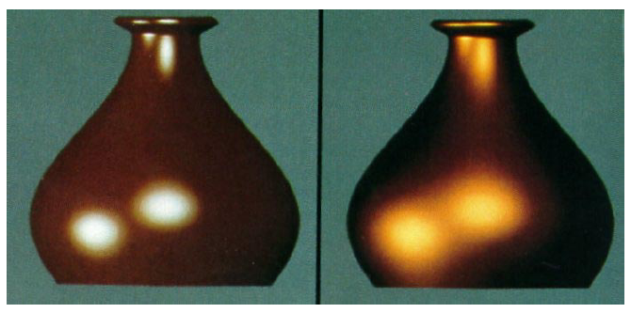
Choosing the Parameters
More specular
More diffuse

Slide 37
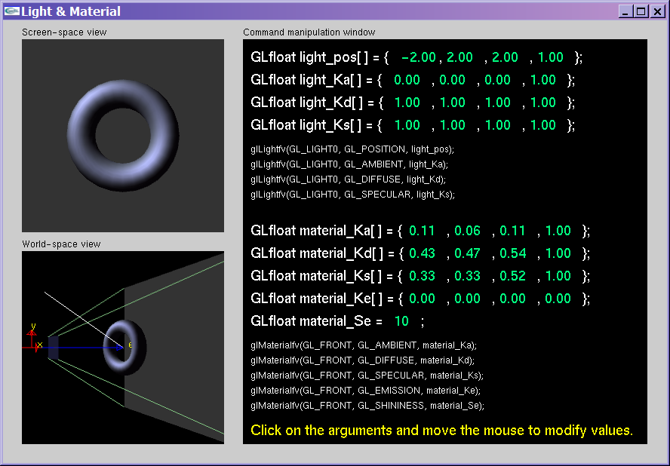
Nate Robin’s lightmaterial.exe
Download this app under “Extras” in the lecture page

Slide 38
Summary for the four components in the Phong Illumination model
 | Emission (0th iteration) | Ambient (1st iteration) | Diffuse (2nd iteration) | Specular (3rd iteration)
Depends on surface property | Y | Y | Y | Y
Depends on light intensity | N | Y | Y | Y
Depends on light direction | N | N | Y | Y
Depends on viewing direction | N | N | N | Y

Slide 39
Summary for Phong Model
The most important thing to take away from this lecture is the final equation for the Phong model.
  What is the physical meaning of each variable?
  How are the terms computed?
  What effect does each term contribute to the image?
  What does varying the parameters do?
Note:
  It allows us to compute the color emitted along a given viewing direction from a given surface point
  This is still an approximation for light-surface interaction; this is still an active research area: there exist a number of more complicated models.

